Slide 1

Spam Filter: Classification Algorithm
Using an Artificial Neural Network

Slide 2

Why Build a Spam Filter?
Spam is bad
Common avenue for fraud
Annoying
Classification problem (”Spam” / “Ham”, 1 / 0)
We need to be able to create a method for identifying spam and blocking it before it lands in someone’s inbox

Slide 3
What are we working with?
 | Label | Feature 1 | … | Feature 54
Example 1 | 1 | 0 | … | 0
Example 2 | 0 | 1 | … | 0
… | … | … | … | …
Example N | 1 | 1 | … | 1

Slide 4
Artificial Neural Networks
54 Feature Inputs

Slide 5
Artificial Neural Networks
Not spam
54 Feature Inputs

Slide 6
Artificial Neural Networks
SPAM!
54 Feature Inputs

Slide 7
Neural Network Workings
Key operations of a Neural Network
Forward Propagation: Use Linear Algebra to multiply the activations of layers with the weights and apply biases until one has an output
Cost function: Calculate the error between the prediction and reality
Backward Propagation: Calculate partial differentials for all the weights and bias relative to the Cost
Once these operations have been performed enough times, the weights and biases should converge on an accurate classifier

Slide 8
1
Forward Propagation

Slide 9

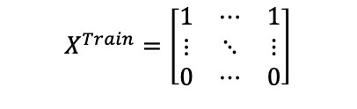

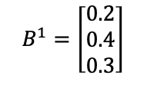
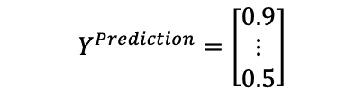


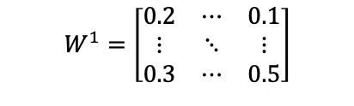

Forward Propagation
$$B^{1}=\left[\begin{matrix}0.2 \\ 0.4 \\ 0.3\end{matrix}\right]$$
$$B^{2}=\left[0.5\right]$$
$$Y^{Prediction}=\left[\begin{matrix}0.9 \\ ⋮ \\ 0.5\end{matrix}\right]$$
54 Feature Inputs
$$W^{2}=\left[\begin{matrix}0.1 & 0.2 & 0.3\end{matrix}\right]$$
$$X^{Train}=\left[\begin{matrix}1 & ⋯ & 1 \\ ⋮ & ⋱ & ⋮ \\ 0 & ⋯ & 0\end{matrix}\right]$$
$$W^{1}=\left[\begin{matrix}0.2 & ⋯ & 0.1 \\ ⋮ & ⋱ & ⋮ \\ 0.3 & ⋯ & 0.5\end{matrix}\right]$$
$$A^{1}=f(X^{Train}∙W^{1}+B^{1})$$
$$Y^{Prediction}=f(A^{1}∙W^{2}+B^{2})$$
$$f(x)=\frac{1}{1+e^{−x}}$$
Y prediction is an example, not the actual result from forward propagation with these values

Slide 10
2
Cost Function

Slide 11
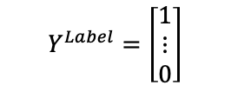
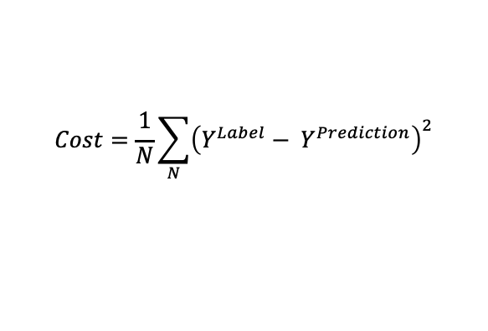
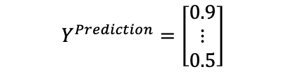
Cost Function
$$Y^{Prediction}=\left[\begin{matrix}0.9 \\ ⋮ \\ 0.5\end{matrix}\right]$$
$$Y^{Label}=\left[\begin{matrix}1 \\ ⋮ \\ 0\end{matrix}\right]$$
$$Cost=\frac{1}{N}\sum_{N}{{\left({Y^{Label}− Y}^{Prediction}\right)}^{2}}$$

Slide 12
3
Backward Propagation

Slide 13
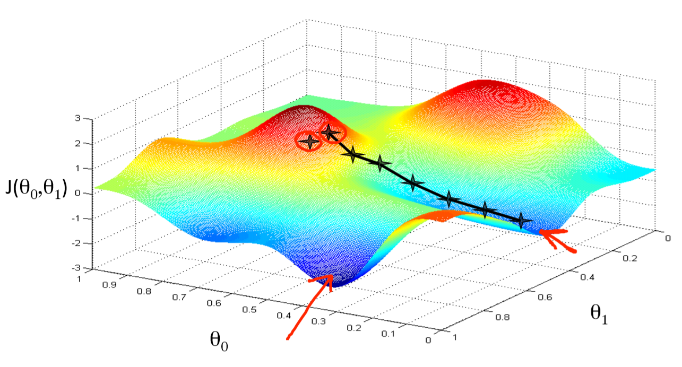
Gradient Descent
https://medium.com/hackernoon/gradient-descent-aynk-7cbe95a778da

Slide 14






Backward Propagation
$$\frac{∂Cost}{∂Y}=2(Y^{Label}−Y^{Prediction})$$
$$\frac{∂Cost}{∂A^{1}}=\frac{∂Z^{2}}{∂A^{1}} \frac{∂Y}{∂Z^{2}} \frac{∂Cost}{∂Y}$$
$$\frac{∂Cost}{∂W^{2}}=\frac{∂Z^{2}}{∂W^{2}}\frac{∂Y}{∂Z^{2}}\frac{∂Cost}{∂A^{2}}$$
$$\frac{∂Cost}{∂B^{2}}=\frac{∂Z^{2}}{∂B^{2}}\frac{∂Y}{∂Z^{2}}\frac{∂Cost}{∂A^{2}}$$
$$\frac{∂Cost}{∂W^{1}}=\frac{∂Z^{1}}{∂W^{1}} \frac{∂A^{1}}{∂Z^{1}} \frac{∂Cost}{∂A^{1}}$$
$$\frac{∂Cost}{∂B^{1}}=\frac{∂Z^{1}}{∂B^{1}} \frac{∂A^{1}}{∂Z^{1}} \frac{∂Cost}{∂A^{1}}$$

Slide 15
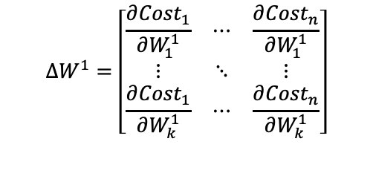
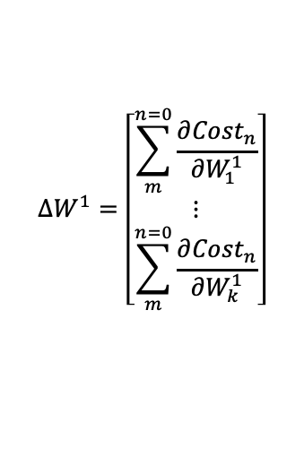
Backward Propagation
$$∆W^{1}=\left[\begin{matrix}\sum_{m}^{n=0}{\frac{∂{Cost}_{n}}{∂W_{1}^{1}}} \\ ⋮ \\ \sum_{m}^{n=0}{\frac{∂{Cost}_{n}}{∂W_{k}^{1}}}\end{matrix}\right]$$
$$∆W^{1}=\left[\begin{matrix}\frac{∂{Cost}_{1}}{∂W_{1}^{1}} & ⋯ & \frac{∂{Cost}_{n}}{∂W_{1}^{1}} \\ ⋮ & ⋱ & ⋮ \\ \frac{∂{Cost}_{1}}{∂W_{k}^{1}} & ⋯ & \frac{∂{Cost}_{n}}{∂W_{k}^{1}}\end{matrix}\right]$$
$$W^{1}=W^{1}−∆W^{1}× learning rate$$

Slide 16
Result

Slide 17
A Not bad Classifier!
ANN with one hidden layer (of 3 nodes) was trained over 5000 epochs with two batches of 500 training examples in each epoch
This ANN produced a set of weights and biases that could predict to an accuracy of 92.6% on the testing data set
There seems to be a method that drops some edges from the graph that can produce a graph that generalises better to testing data – this would be an interesting thing to investigate

Slide 18
Thanks

